Slide 1
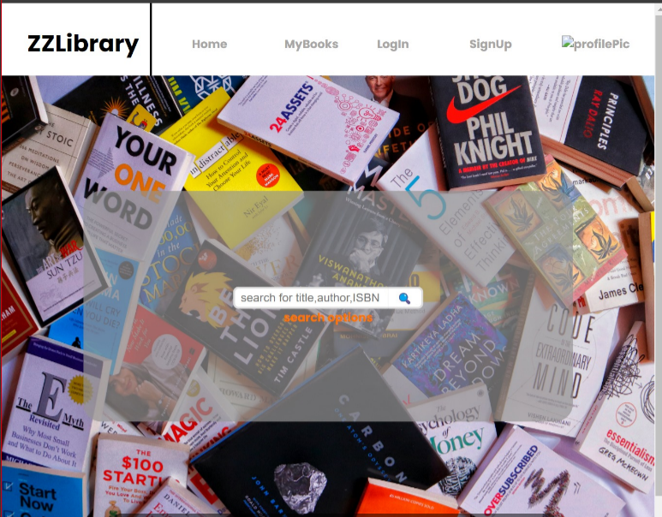
ZZ Library
Himanshu Sharma
Pujal Arora
Jiahan Sui

Slide 2

Introduction
In ZZ Library, user can search for different types of books, can signup for the library’s access, can put their favorite books under one category and can even divide the categories as want to read, currently reading and read.

Slide 3





Features
Library Cataloging
A strong foundation supporting efficient library cataloging and inventory management
Intuitive user interface
Streamlined dashboards and search capabilities ensure a seamless user experience.
Role Differentiation
User can search for books, can favorite books, and divide books into different categories
Executive powers
Managing user account, change passwords, creating different sections related to books.
Refinement choices
Simplified book searches for users, enabling users to categories creating a user friendly experience.

Slide 4
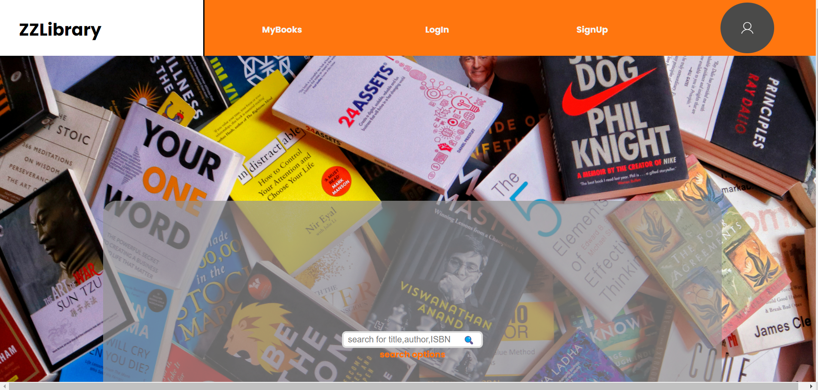
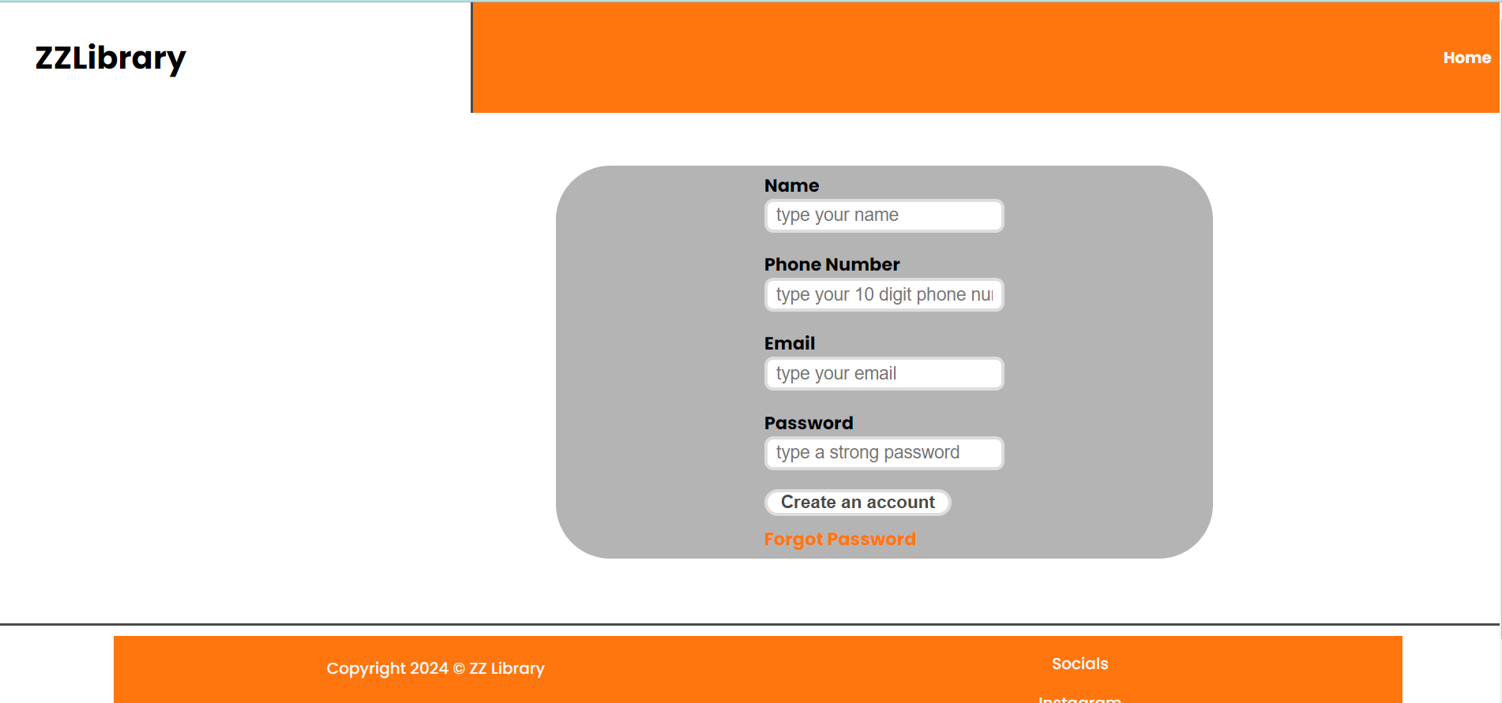
Home Page and signup page

Slide 5
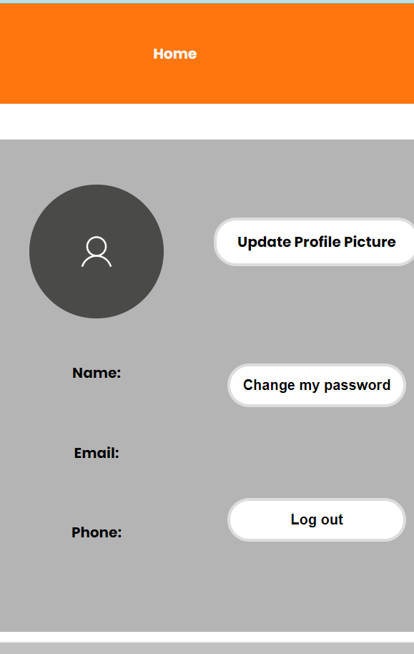
Summary
In conclusion, ZZ Library provides a user-friendly experience which allows user to signup for the library, login and even change the password! It includes information about the author

Slide 6

Thank you
Himanshu Sharma
Jiahan Sui
Pujal Arora

